Slide 1
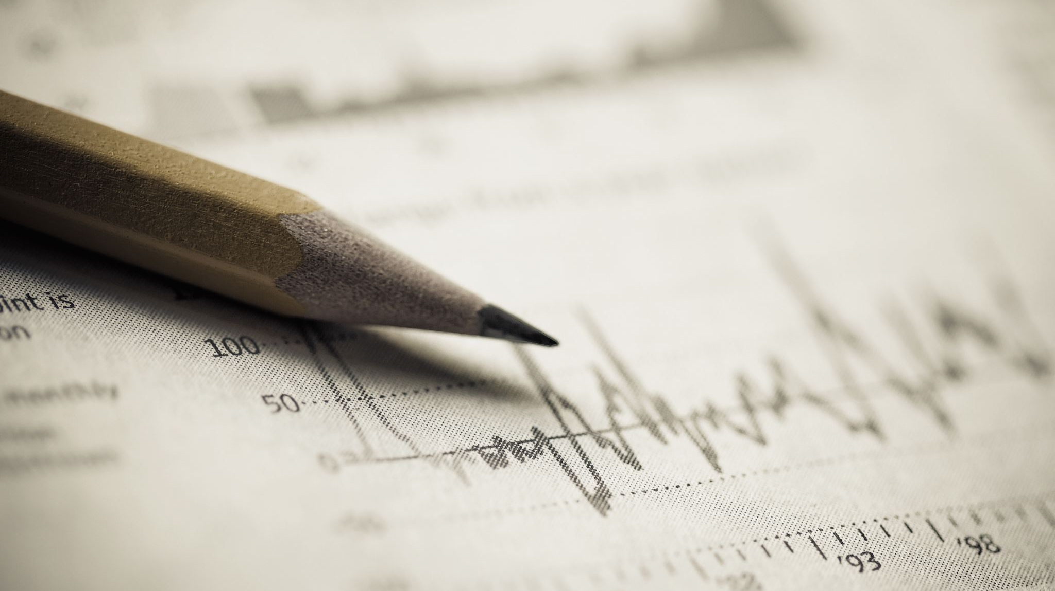
Handwritten Text Recognizer
- John Jim Evans Veernapati
Notes:
Hello Everyone, I am John Jim Evans Veernapati. This video gives the progress in my Capstone project. As I have mentioned in my proposal, I am trying to detect the handwritten text on cheques to help avoid the manual errors. A major change would be extending the project to detect more handwritten words. So, I had to change my project name.

Slide 2
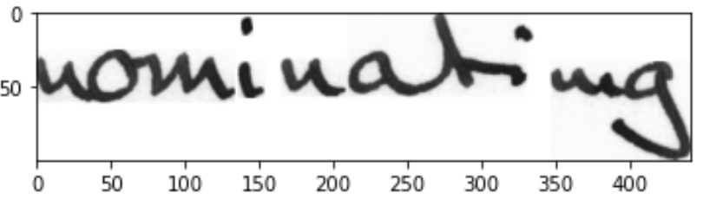
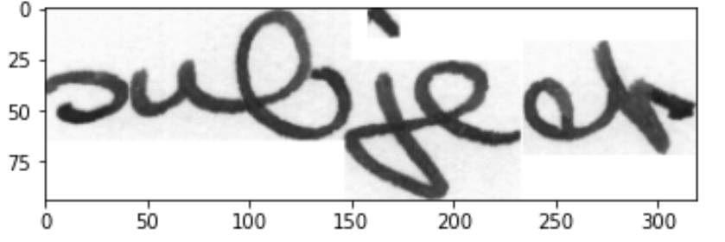
DATA SOURCE
IAM Handwritten Text Database 3.0
657 writers contributed samples of their handwriting
115'320 isolated and labeled words
Approximately 1 GB
Pictures of the words
Sample Data
Link
http://www.fki.inf.unibe.ch/databases/iam-handwriting-database/iam-handwriting-database#icdar02
Notes:
For the data source, I have looked for hand written database and found this data source interesting. IAM Handwritten Text Database has over 1 lakh words labelled and are contributed by 657 writers. The words are extracted from scanned written texts and are manually labeled. These words are stored in the form of pictures. The size of the data is approximately 1 GB. Here are the examples of the pictures of the words. The link to the data source is down below. We have to register on the site to access the data. I will also add the link to data source in the description section of this video.

Slide 3
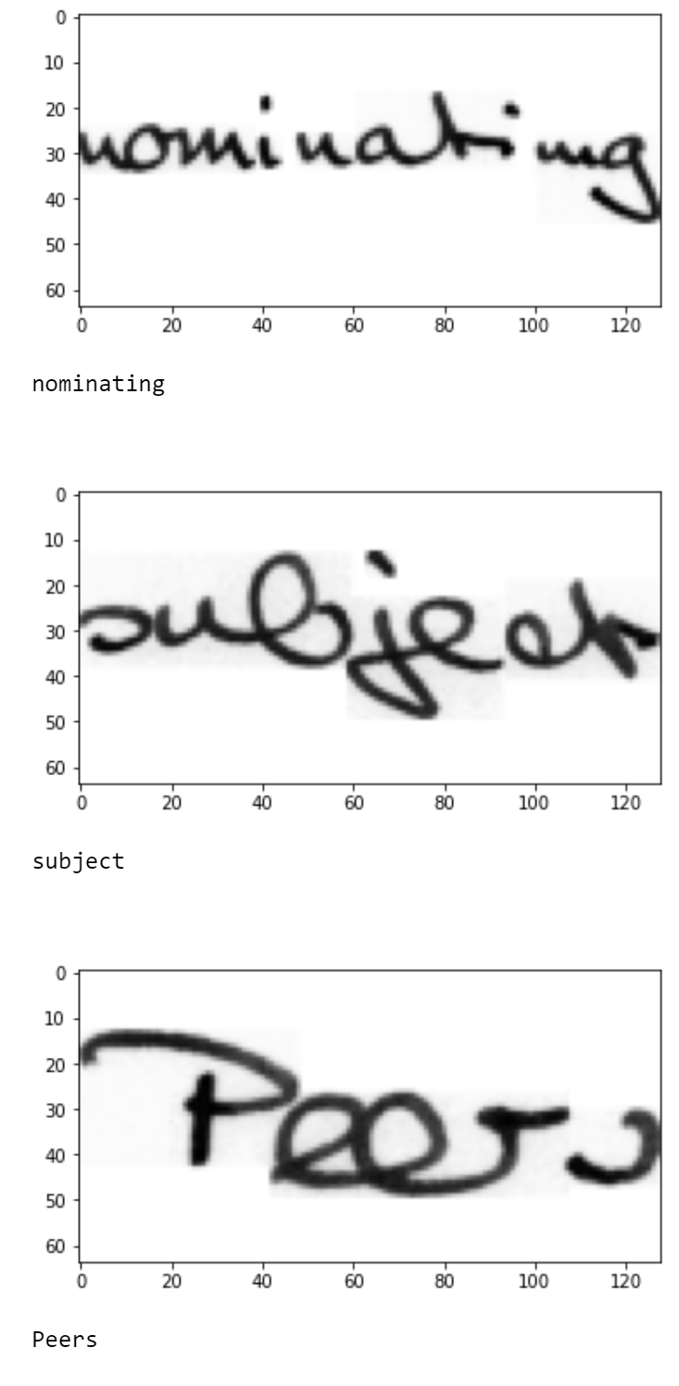
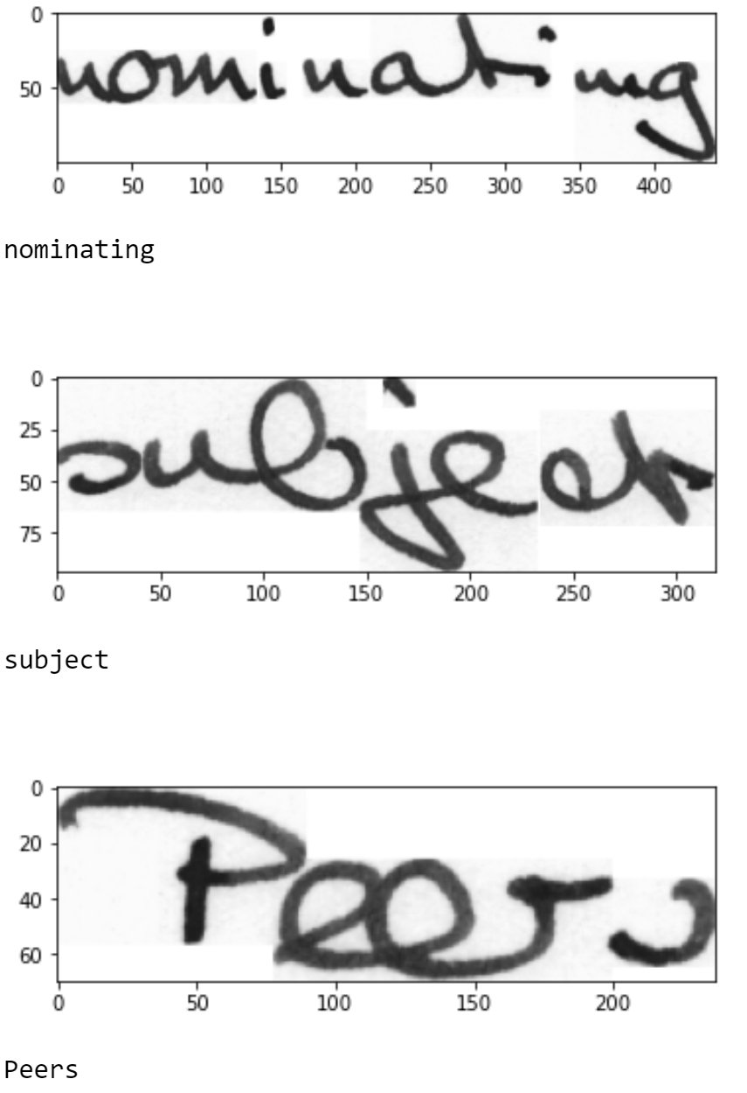
Before Processing After Processing

Slide 4
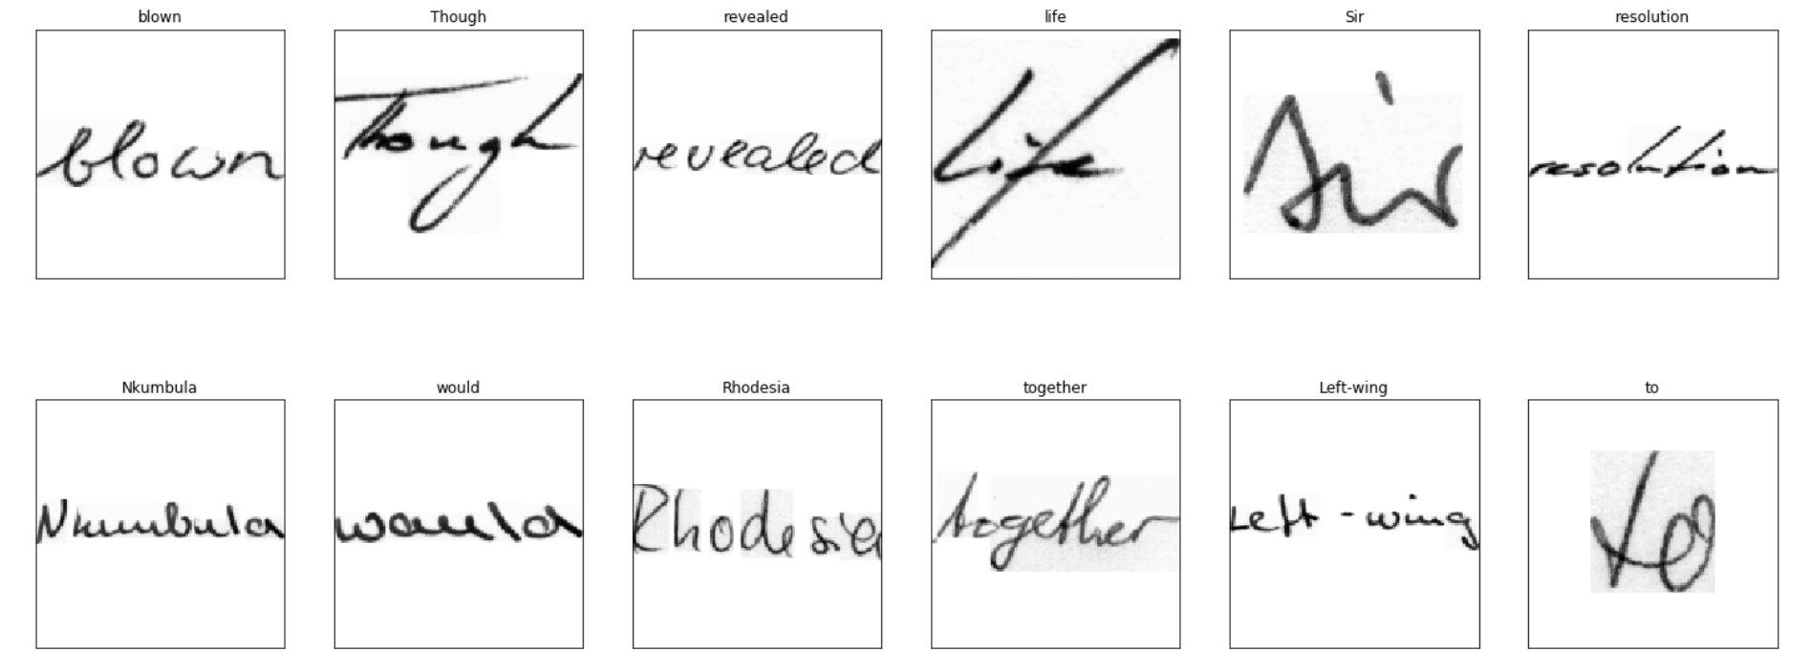
More Images

Slide 5
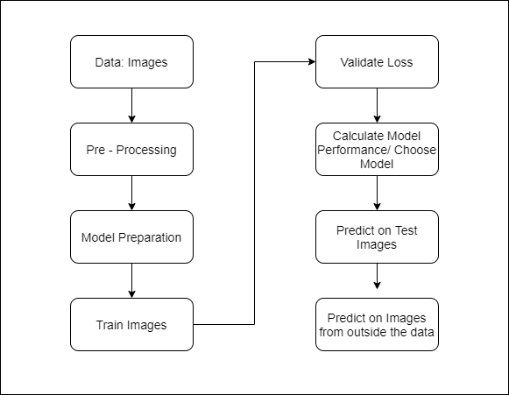
PROJECT LIFE CYCLE

Slide 6
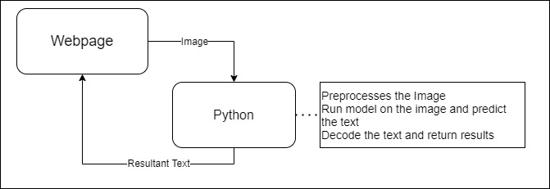
APPLICATION OVERALL ARCHITECTURE
Flask Application
Draw an image on the canvas text box (Webpage)
Save the image, and send it as an input to the model
Machine Learning Algorithm
Preprocess the Image
Send input to the model
Return the results and decode the results
Send result to the Webpage
Webpage
Return the results from the Webpage

Slide 7
DEMO

Slide 8
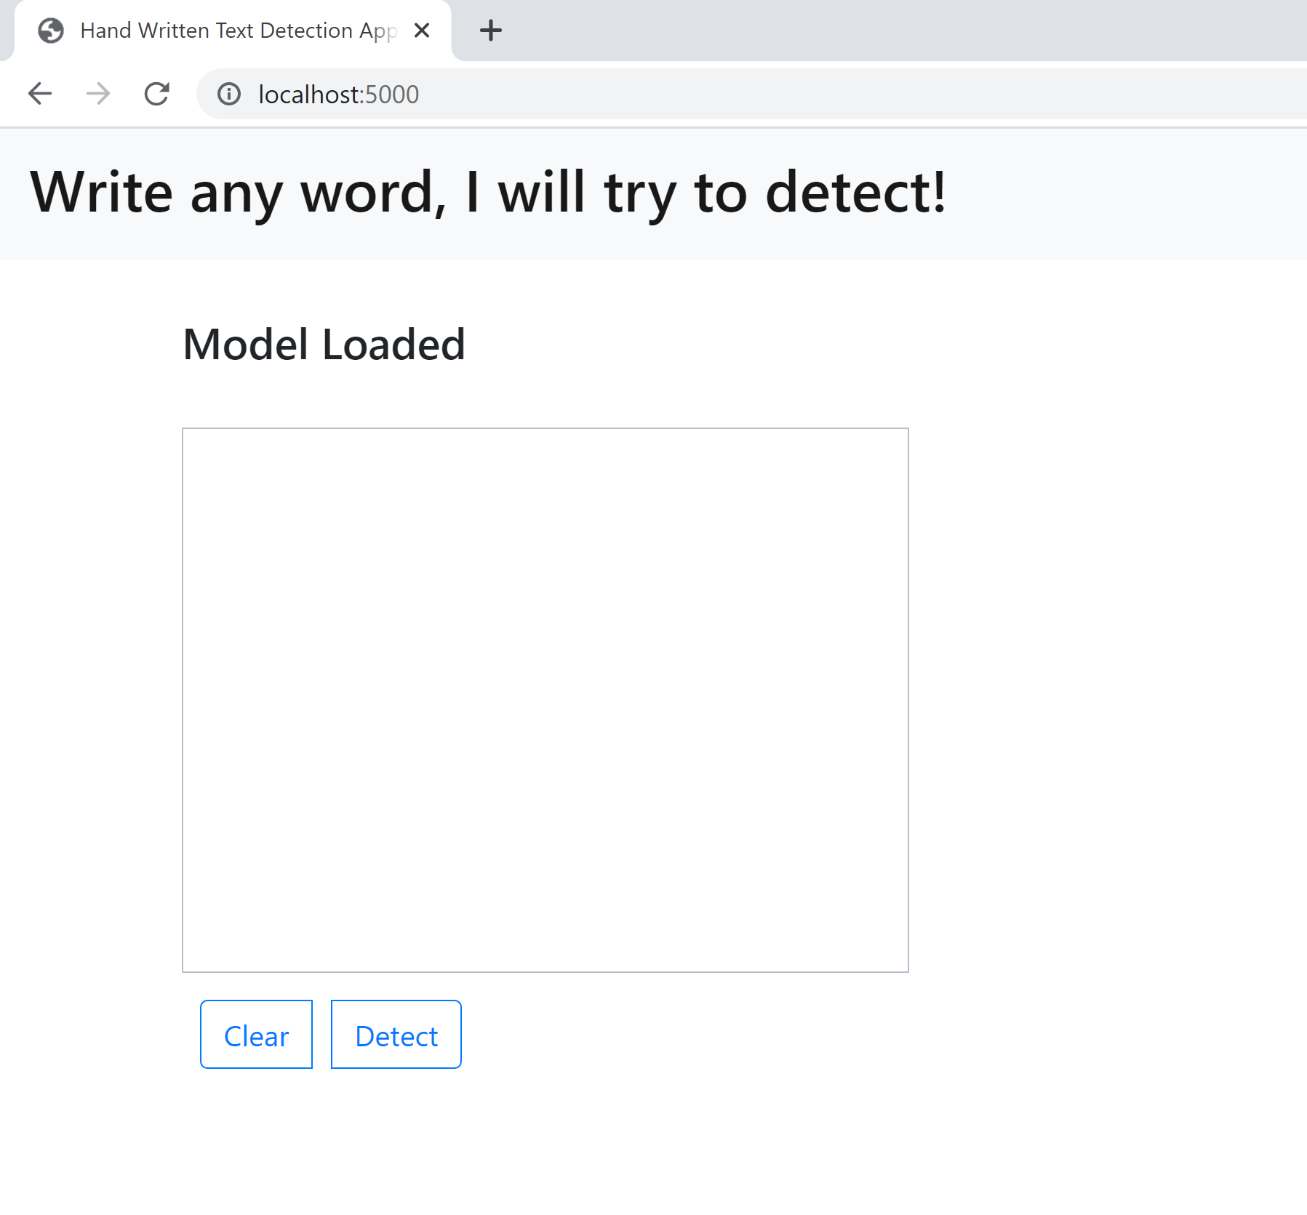
Homepage

Slide 9
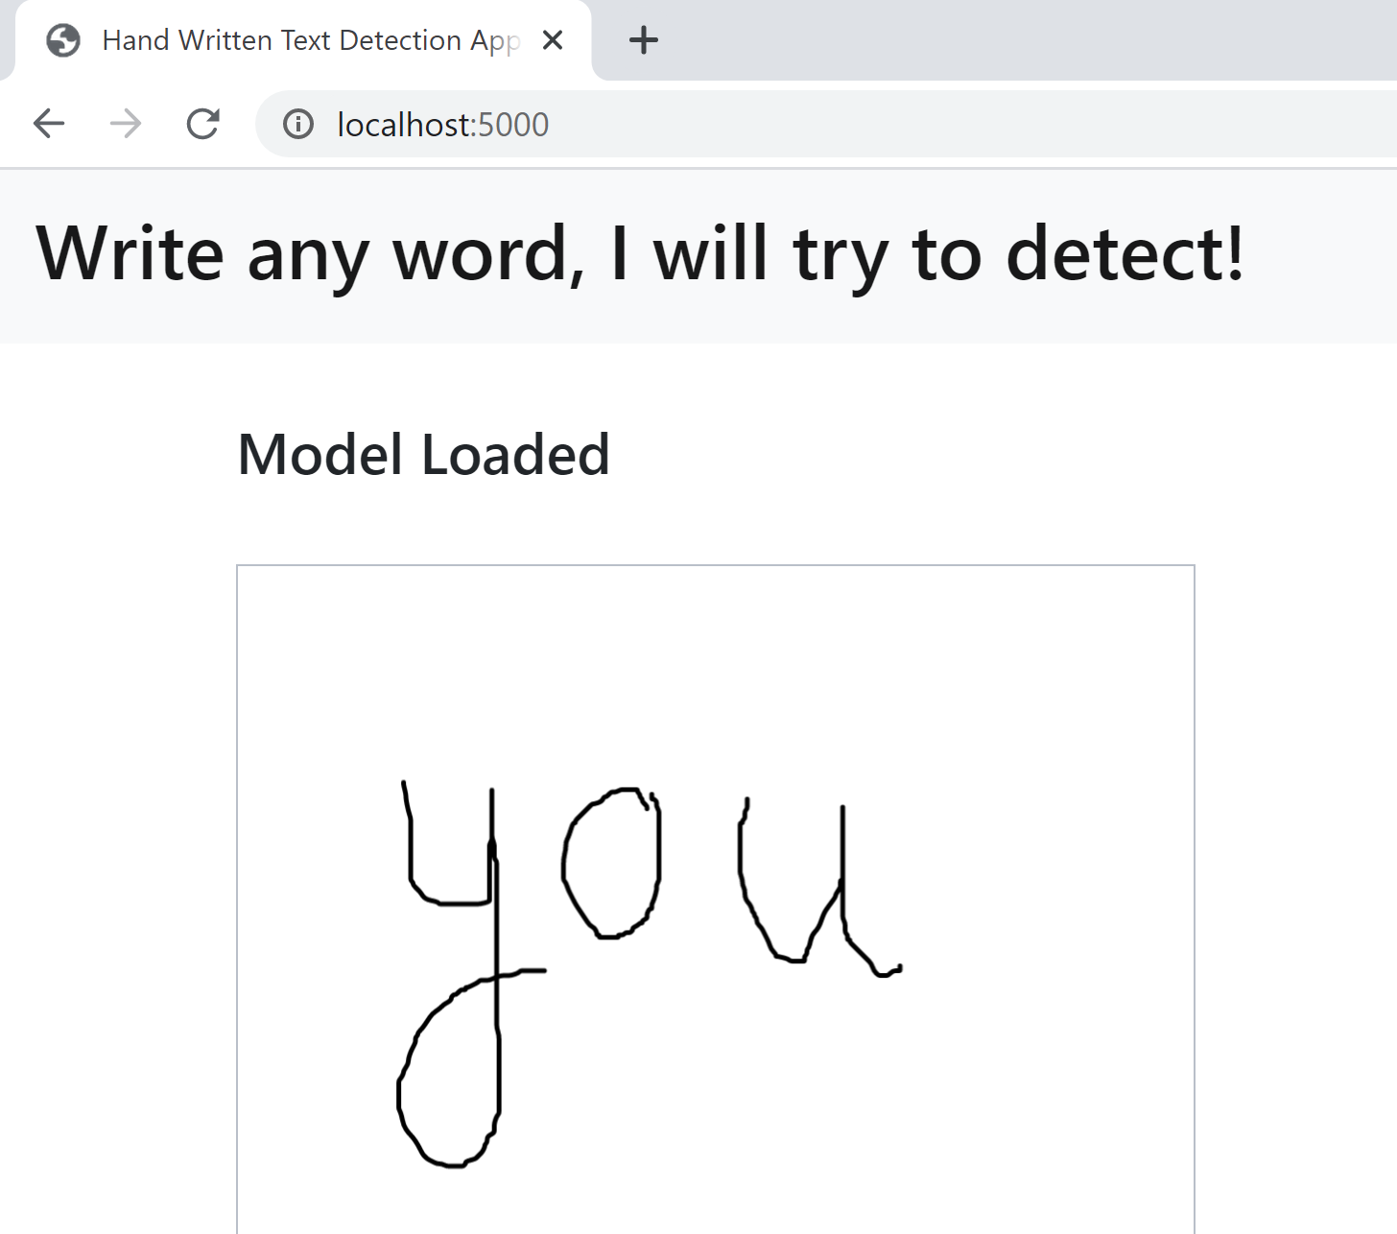
Image Drawn

Slide 10
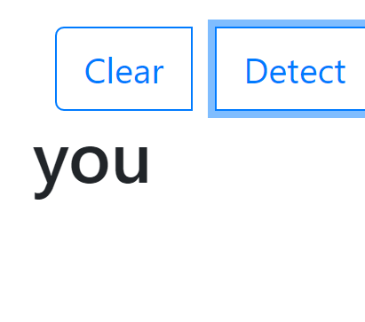
Results Displayed

Slide 11
Learnings
Good understanding on Deep Learning, implementation of Deep Learning Algorithms
Interactive Implementation of developed Project
Coding using environments
Flask Framework, creating a simple application
Webpage creation
Failures
Automatic Text Detection from an uploaded image (Failed to work on tesseract Code)
Implementation of Cheque Scanning

Slide 12

Thank you
Questions and Feedback?
jimevans.v@umbc.edu
https://github.com/jimevansv/Data_606

